Slide 1
“Membership has its privileges.”

Slide 2
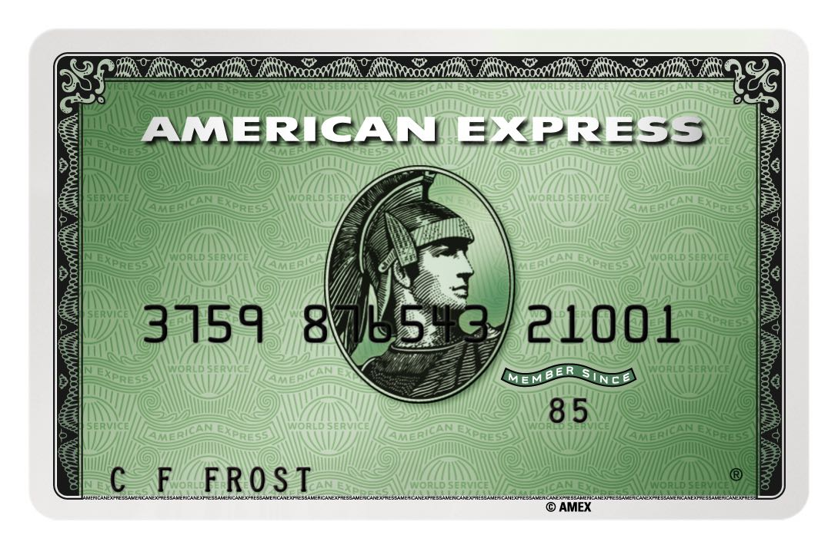
“Membership has its privileges.”

Slide 6
“I wouldn’t want to be a member of any club that would have me as a member.”

Slide 7
“Proud, Passionate, Paid-up”

Slide 8
Commitment Phobia

Slide 9
Commitment Phobia

Slide 10
Consumerism.

Slide 11
1 Corinth. 5:1 – 12 expulsion from church of an unrepentant person continuing in blatant sin.

Slide 12
1 Corinth. 5:1 – 12 expulsion from church of an unrepentant person continuing in blatant sin.
Matt. 18:15 – 17 Church to discipline its members

Slide 13
1 Corinth. 5:1 – 12 expulsion from church of an unrepentant person continuing in blatant sin.
Matt. 18:15 – 17 Church to discipline its members
Heb. 13:17 “Obey your leaders and submit to their authority. They keep watch over you as men who must give an account.”

Slide 14
1 Corinth. 5:1 – 12 expulsion from church of an unrepentant person continuing in blatant sin.
Matt. 18:15 – 17 Church to discipline its members
Heb. 13:17 “Obey your leaders and submit to their authority. They keep watch over you as men who must give an account.”
Phil. 1:1 “To all the saints in Christ Jesus at Philippi, together with the overseers and deacons.”

Slide 15
1 Corinth. 5:1 – 12 expulsion from church of an unrepentant person continuing in blatant sin.
Matt. 18:15 – 17 Church to discipline its members
Heb. 13:17 “Obey your leaders and submit to their authority. They keep watch over you as men who must give an account.”
Phil. 1:1 “To all the saints in Christ Jesus at Philippi, together with the overseers and deacons.”
1 Pet. 5:2 – 3 “Be shepherds of God’s flock that is under your care, serving as overseers.”

Slide 16
1 Corinth. 5:1 – 12 expulsion from church of an unrepentant person continuing in blatant sin.
Matt. 18:15 – 17 Church to discipline its members
Heb. 13:17 “Obey your leaders and submit to their authority. They keep watch over you as men who must give an account.”
Phil. 1:1 “To all the saints in Christ Jesus at Philippi, together with the overseers and deacons.”
1 Pet. 5:2 – 3 “Be shepherds of God’s flock that is under your care, serving as overseers.”
Add: 1 Thess. 5:12 – 13, Acts 20:28,

Slide 17
2 Corinth. 2:6 – 7 “the majority.”

Slide 18
2 Corinth. 2:6 – 7 “the majority.”
1 Timothy 5:9 “List of widows.”

Slide 19
2 Corinth. 2:6 – 7 “the majority.”
1 Timothy 5:9 “List of widows.”
Acts 2:37 – 47 Numerical record

Slide 20
2 Corinth. 2:6 – 7 “the majority.”
1 Timothy 5:9 “List of widows.”
Acts 2:37 – 47 Numerical record
Philippians 4:3 “Whose names are in the book of life.”

Slide 21
Criteria for acceptance into Membership
1. Demonstrated and attested to a committed faith in Jesus Christ as Lord and Saviour
2. Membership preparation class: constitutional
3. Baptism – we are Baptists after all. One of our defining doctrines.
4. Your membership must be approved at a properly constituted Church meeting

Slide 22
Requirements/Expectations of membership of HBC

Slide 23
Requirements/Expectations of membership of HBC
Commitment to your own spiritual growth and discipleship

Slide 24
Requirements/Expectations of membership of HBC
Commitment to your own spiritual growth and discipleship
Commitment to growth and discipleship of others, by
participating with them and investing in them

Slide 25
Requirements/Expectations of membership of HBC
Commitment to your own spiritual growth and discipleship
Commitment to growth and discipleship of others, by
participating with them and investing in them
3. Willingness to be held accountable

Slide 26
Requirements/Expectations of membership of HBC
Commitment to your own spiritual growth and discipleship
Commitment to growth and discipleship of others, by
participating with them and investing in them
3. Willingness to be held accountable
Commitment to the celebration of the Body of Christ in
worship, prayer, giving and serving

Slide 27
Requirements/Expectations of membership of HBC
Commitment to your own spiritual growth and discipleship
Commitment to growth and discipleship of others, by
participating with them and investing in them
3. Willingness to be held accountable
Commitment to the celebration of the Body of Christ in
worship, prayer, giving and serving
5. Commitment to love and grace as our highest relational values

Slide 28
Requirements/Expectations of membership of HBC
Commitment to your own spiritual growth and discipleship
Commitment to growth and discipleship of others, by
participating with them and investing in them
3. Willingness to be held accountable
Commitment to the celebration of the Body of Christ in
worship, prayer, giving and serving
5. Commitment to love and grace as our highest relational values
6. Commitment to integrity in Christian living

