Slide 1
“Don’t let anyone look down on you because you are young, but set an example for the believers in speech, in life, in love, in faith and in purity.”
1 Timothy 4:12 (NIV)

Slide 2
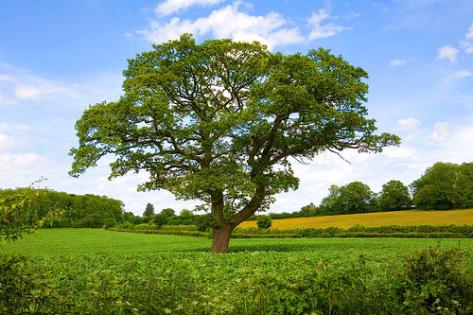

Slide 9
“Disciples Don’t Grow On Trees”

Slide 10
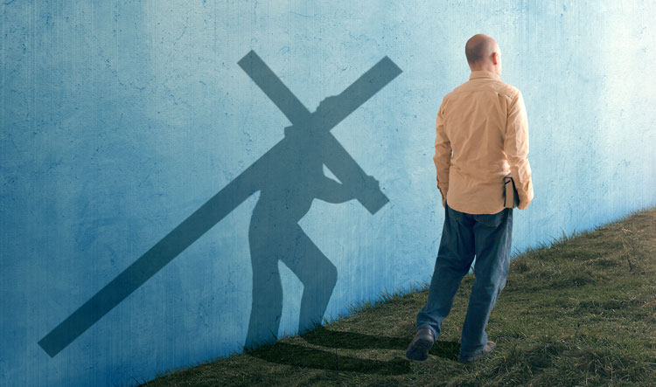
A disciple is . .

Slide 11
A disciple is . . .
* A believer in Christ

Slide 12
A disciple is . . .
* A believer in Christ
* Who becomes a follower of Christ

Slide 13
A disciple is . . .
* A believer in Christ
* Who becomes a follower of Christ
* By submitting

Slide 14
A disciple is . . .
* A believer in Christ
* Who becomes a follower of Christ
* By submitting
* To an intentional process

Slide 15
A disciple is . . .
* A believer in Christ
* Who becomes a follower of Christ
* By submitting
* To an intentional process
* Of the disciplines of

Slide 16
A disciple is . . .
* A believer in Christ
* Who becomes a follower of Christ
* By submitting
* To an intentional process
* Of the disciplines of
* Learning and growing to be like Christ

Slide 17
A disciple is . . .
* A believer in Christ
* Who becomes a follower of Christ
* By submitting
* To an intentional process
* Of the disciplines of
* Learning and growing to be like Christ
* And that process comes under the
deliberate oversight and guidance of
a mature Christian.

Slide 19
Lessons from Timothy, from Acts 16

Slide 20
Lessons from Timothy, from Acts 16:
“You know you’re a disciple when . . . .”

Slide 21
Lessons from Timothy, from Acts 16:
“You know you’re a disciple when . . . .”
A disciple is known. V1

Slide 22
Lessons from Timothy, from Acts 16:
“You know you’re a disciple when . . . .”
A disciple is known. V1
A disciple is of good repute: V2

Slide 23
Lessons from Timothy, from Acts 16:
“You know you’re a disciple when . . . .”
A disciple is known. V1
A disciple is of good repute: V2
A disciple is available V3

Slide 24
Lessons from Timothy, from Acts 16:
“You know you’re a disciple when . . . .”
A disciple is known. V1
A disciple is of good repute: V2
A disciple is available V3
“You are not your own; you were bought with a price.
Therefore, honour God with your body.” 1 Corinth. 6:19 – 20 (NIV)

Slide 25
Lessons from Timothy, from Acts 16:
“You know you’re a disciple when . . . .”
A disciple is known. V1
A disciple is of good repute: V2
A disciple is available V3
4. A disciple pays the price. V3

Slide 26
Lessons from Timothy, from Acts 16:
“You know you’re a disciple when . . . .”
A disciple is known. V1
A disciple is of good repute: V2
A disciple is available
4. A disciple pays the price. V3
Disciples are under ‘divine steering.’ V6 – 9

Slide 27
Lessons from Timothy, from Acts 16:
“You know you’re a disciple when . . . .”
A disciple is known. V1
A disciple is of good repute: V2
A disciple is available
4. A disciple pays the price. V3
Disciples are under ‘divine steering.’ V6 – 9
6. Disciples makes disciples. V5

Slide 28
Lessons from Timothy, from Acts 16:
“You know you’re a disciple when . . . .”
A disciple is known. V1
A disciple is of good repute: V2
A disciple is available
4. A disciple pays the price. V3
Disciples are under ‘divine steering.’ V6 – 9
6. Disciples makes disciples. V5
“So the churches were strengthened in their
faith and grew larger every day.” Acts 16:5 (NLT)

Slide 29
Lessons from Timothy, from Acts 16:
“You know you’re a disciple when . . . .”
A disciple is known. V1
A disciple is of good repute: V2
A disciple is available
4. A disciple pays the price. V3
Disciples are under ‘divine steering.’ V6 – 9
6. Disciples makes disciples. V5
7. A disciple is always “in the making,” rather than made.
Philippians 1:6

Slide 30
“This is my strategy for building my church so that
the gates of hell cannot prevail against it: I’ll have
an army of disciple-makers.”

