Slide 1
Starring . . . .

Slide 3
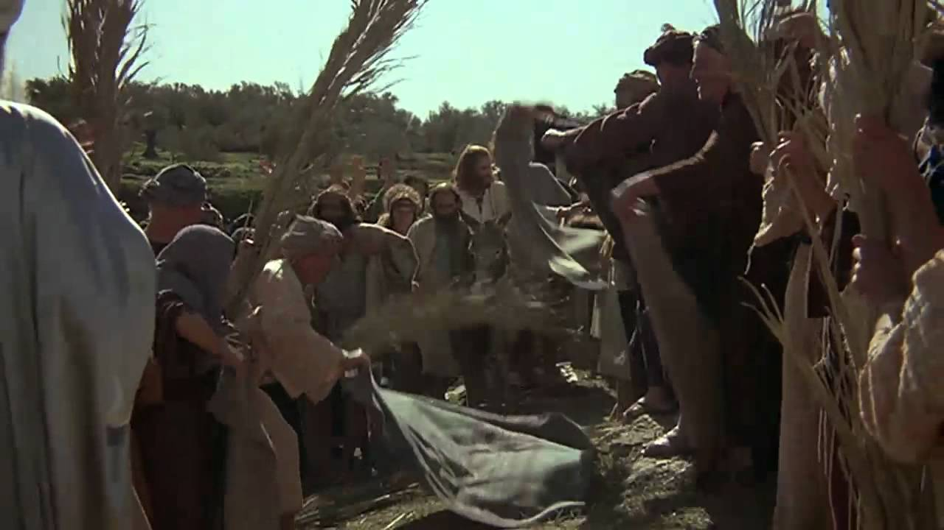
Crowds

Slide 4
Crowds
Donkey

Slide 5
Crowds
Donkey
Clothes

Slide 6
Palm branches
Crowds
Donkey
Clothes

Slide 7
Palm branches
Praises
Crowds
Donkey
Clothes

Slide 8
“Save now, I pray.”

Slide 9
“Save now, I pray.”
“Save now, you who is in the highest heaven.”

Slide 10
“Hail to the King of Israel.”

Slide 11
“Only a few days ago the people (in Judea) were trying to stone you. Are you going there again?”
John 11:8 (NLT)

Slide 12
What did they think of Jesus?

Slide 13
What did they think of Jesus?
What did they expect of Jesus?

Slide 14
What did they think of Jesus?
What did they expect of Jesus?
What were they prepared to lay at the feet of Jesus as a declaration of his Sovereignty?

Slide 15
