Slide 1
“It is best for you that I go away, because if I don’t, the Advocate won’t come. If I do go away, then I will send him to you.”
John 16:7 (NLT)

Slide 2
1. Reality that Jesus was gone.

Slide 3
1. Reality that Jesus was gone.
2. Command

Slide 4
1. Reality that Jesus was gone.
2. Command
3. Promise

Slide 8
“Now you must be Holy in everything you do, just as God who chose you is Holy. For the Scriptures say, “You must be Holy because I am Holy.” 1 Peter 1:15-16 (NLT)

Slide 9
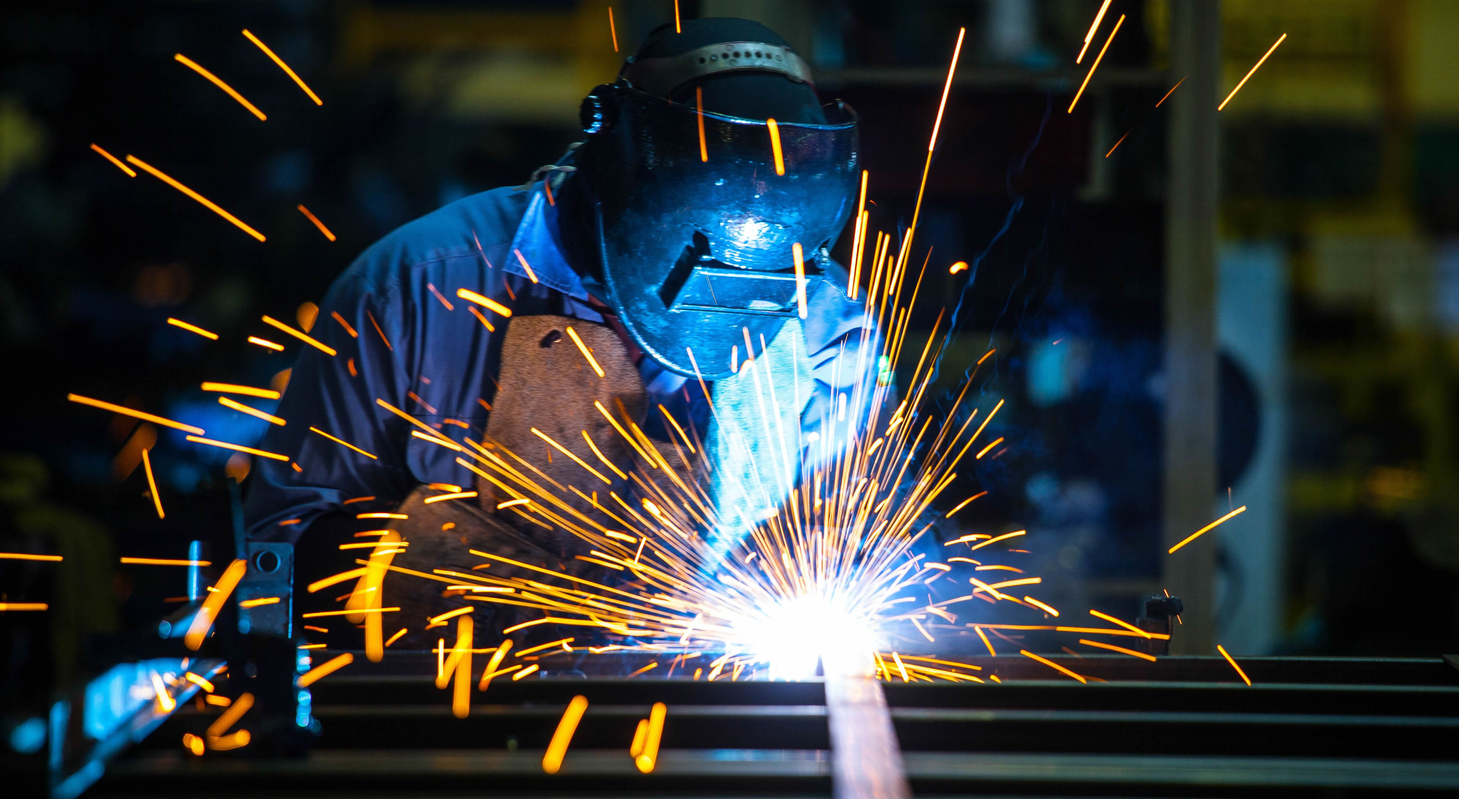

Slide 11
“All of us who have had that veil removed can see and reflect the glory of the Lord. And the Lord – who is the Spirit – makes us more and more like Him as we are changed into His glorious image.” 2 Corinth: 3:18 (NLT)

Slide 12
“They all met together and were constantly united in prayer.”
Acts 1:14 (NLT)

Slide 13
“They all met together and were constantly united in prayer.”
Acts 1:14 (NLT)

Slide 14
“They all met together and were constantly united in prayer.”
Acts 1:14 (NLT)

Slide 15
“They all met together and were constantly united in prayer.”
Acts 1:14 (NLT)

Slide 16
“They all met together and were constantly united in prayer.”
Acts 1:14 (NLT)

Slide 17
“They all met together and were constantly united in prayer.”
Acts 1:14 (NLT)

Slide 18
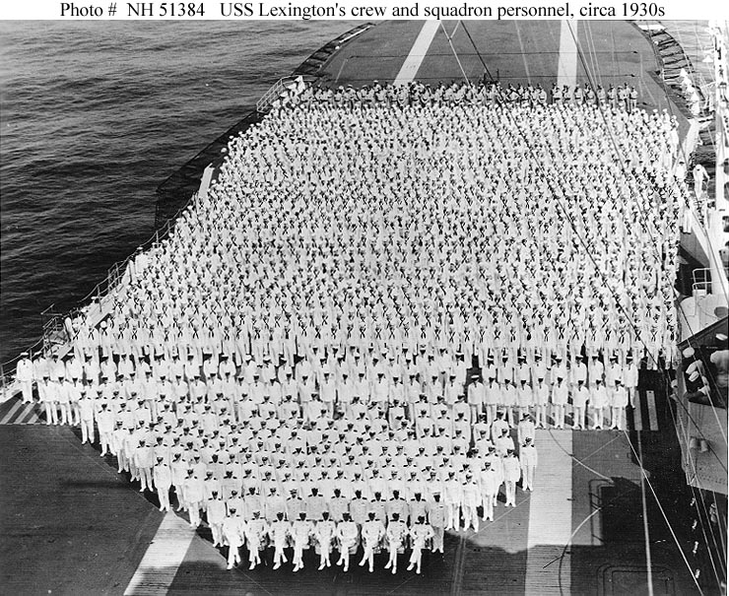

Slide 20
Disciple:

Slide 21
Disciple: follower, learner, student, pupil,

Slide 22
Disciple: follower, learner, student, pupil,
Apostle:

Slide 23
Disciple: follower, learner, student, pupil,
Apostle: messenger, sent one, one sent with a message

Slide 24
“This will continue until we all come to such unity in our faith and knowledge of God’s Son that we will be mature in the Lord, measuring up to the full and complete standard of Christ.”
Ephesians 4:13

Slide 25
“Whoever is chosen will join us as
a witness of Jesus’ resurrection.”
Acts 1:22 (NLT)

Slide 26
“In those days, Peter stood up
among the believers.”
Acts 1:22 (NIV)

Slide 27
“In those days, Peter stood up
among the believers.”
Acts 1:22 (NIV)

Slide 28
“In those days, Peter stood up
among the believers.”
Acts 1:22 (NIV)
Stand Up And Be Counted!

Slide 29
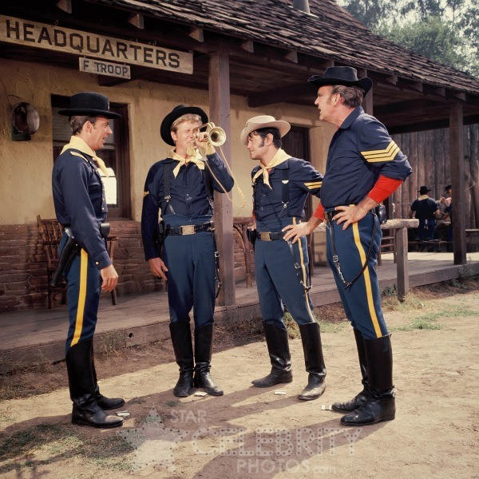

Slide 30
