Slide 6
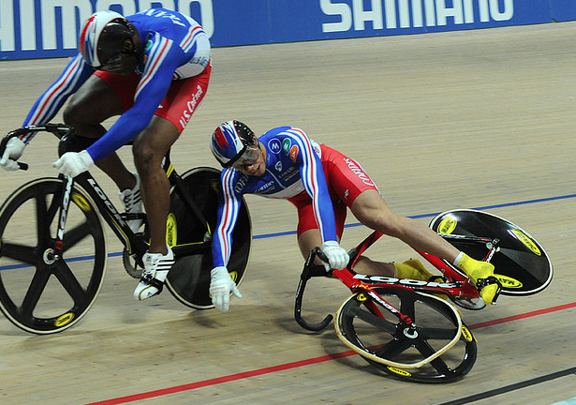

Slide 9
“And you are living stones that God is building into his spiritual temple. What’s more, you are his holy priests.” 1 Peter 2:5 (NLT)

Slide 10
“And you are living stones that God is building into his spiritual temple. What’s more, you are his holy priests.” 1 Peter 2:5 (NLT)
“Love each other with genuine affection, and take delight in honouring each other.” Romans 12:10 (NLT)

Slide 11
“And you are living stones that God is building into his spiritual temple. What’s more, you are his holy priests.” 1 Peter 2:5 (NLT)
“Love each other with genuine affection, and take delight in honouring each other.” Romans 12:10 (NLT)
“May God, who gives this patience and encouragement, help you live in complete harmony with each other, as is fitting for followers of Christ Jesus.” Romans 15:5 (NLT)

Slide 12
“And you are living stones that God is building into his spiritual temple. What’s more, you are his holy priests.” 1 Peter 2:5 (NLT)
“Love each other with genuine affection, and take delight in honouring each other.” Romans 12:10 (NLT)
“May God, who gives this patience and encouragement, help you live in complete harmony with each other, as is fitting for followers of Christ Jesus.” Romans 15:5 (NLT)
“Above all, clothe yourselves with love, which binds us all together in perfect harmony.” Colossians 3:14 (NLT)

Slide 13
“So now I am giving you a new commandment: Love each other. Just as I have loved you, you should love each other. Your love for one another will prove to the world you are my disciples.” John 13:34 – 35 (NLT)

Slide 15
Under pressure, we should be inseparable!

Slide 16
“How Glued Are You?”

Slide 17
“Flotex Christians”

Slide 18
Facts of the matter:

Slide 19
Facts of the matter:
1. Conflict is inevitable

Slide 20
Facts of the matter:
1. Conflict is inevitable
2. Because we’re all different.

Slide 21
Facts of the matter:
1. Conflict is inevitable
2. Because we’re all different.
3. Can be most constructive and
productive

Slide 22
Facts of the matter:
1. Conflict is inevitable
2. Because we’re all different.
3. Can be most constructive and
productive
4. Too often destructive

Slide 23
God can take the worst of us and turn it to his glory.

Slide 24
Galatians 6:14 – 15 (NLT)
“As for me, may I never boast about anything except the cross of our Lord Jesus Christ. Because of that cross, my interest in this world has been crucified, and the world’s interest in me has also died. It doesn’t matter whether we’ve been circumcised or not. What counts is whether we’ve been transformed into a new creation.”

Slide 25
* Forgive someone
* Apologise to someone, ask their forgiveness
* Restore a strained or fractured relationship
* Resolve a lingering conflict
* Cross the floor to deepen a relationship with someone you
know you tend to avoid
* Commit to never take offence, and never knowingly give
offence.
* Finally dare to tell that person about Jesus

Slide 26
Galatians 6:14 – 15 (NLT)
“As for me, may I never boast about anything except the cross of our Lord Jesus Christ. Because of that cross, my interest in this world has been crucified, and the world’s interest in me has also died. It doesn’t matter whether we’ve been circumcised or not. What counts is whether we’ve been transformed into a new creation.”

Slide 27
Galatians 6:14 – 15 (NLT)
“As for me, may I never boast about anything except the cross of our Lord Jesus Christ. Because of that cross, my interest in this world has been crucified, and the world’s interest in me has also died. It doesn’t matter whether we’ve been circumcised or not. What counts is whether we’ve been transformed into a new creation.”
Paul and Barnabas’s reconciliation: Colossians 4:10, 2 Timothy 4:11, Philemon 24.

