Slide 1
Seven men
chosen to serve
Acts 6:1-7

Slide 3
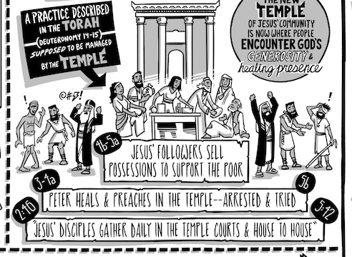

Slide 4
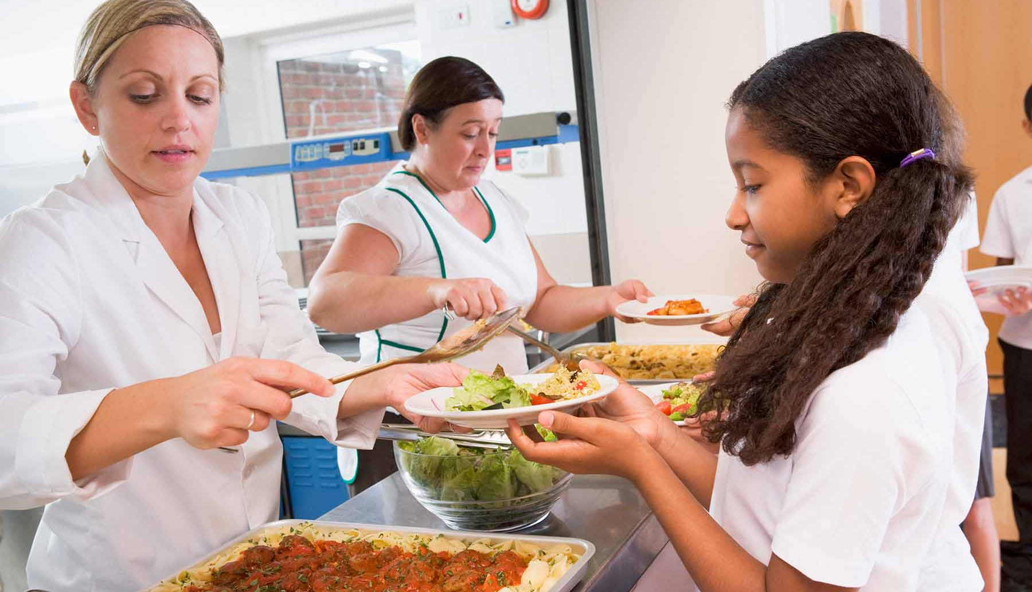
The Church that serves
1 Peter 1:3-5

Slide 5
In those days when the number
of disciples was increasing,
the Hellenistic Jews among them complained against the Hebraic Jews because their widows were being overlooked in the
daily distribution of food.
Acts 6:1

Slide 6
Disciples: learners, those
following the way of Jesus

Slide 7
Disciples: learners, those
following the way of Jesus
Worshipper of Jesus
Servant of Jesus
Witness of Jesus

Slide 8
In those days when the number
of disciples was increasing,
the Hellenistic Jews among them complained against the Hebraic Jews because their widows were being overlooked in the
daily distribution of food.
Acts 6:1

Slide 9
Mumuring:
Moses and the murmuring of the
Israelites wandering in the desert
Brings tension & division

Slide 10
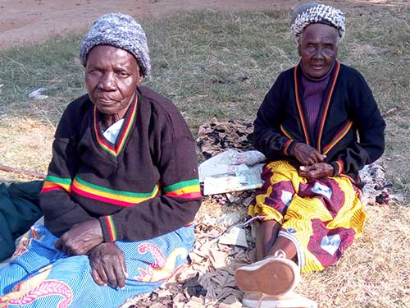
God is a father to the fatherless
and a champion of the widow
Psalm 68:5

Slide 11
The necessity of the Church to
meet practical needs

Slide 12
Don’t be obsessed with
getting your own advantage.
Forget yourselves long enough
to lend a helping hand.
Phil. 2:4

Slide 13
SELF

Slide 14
There is no one like Timothy
for having a real interest in you;
everyone else seems to be worrying
about his own plans
and not those of Jesus Christ.
Phil. 2:20-21

Slide 15
“As we continue to reduce the
physical burden it takes to move
through the world - how will we galvinize the real love of God and neighbour?
In theory, we want to love more, but
in reality we want it to tax us less.”

Slide 16
“But following Christ, we are radically
called to the bother of this world with
its attendant burdens and griefs.
Love is the radical embrace
of burden, not the rejection of it.”

Slide 17
“Perhaps I can remember that love patterned after God’s own self giving,
is bent on inconvenience and cost.
Perhaps I can temper my expectations
for the effortless life I think I am owed.”

Slide 18
“Perhaps I can remember,
when feeling especially put out
by needing to show up in the world
(and not by proxy), that I am
supposed to love with my body.
As God did with His.”
“Perhaps I can remember,
when feeling especially put out
by needing to show up in the world
(and not by proxy), that I am
supposed to love with my body.
As God did with His.”

Slide 19
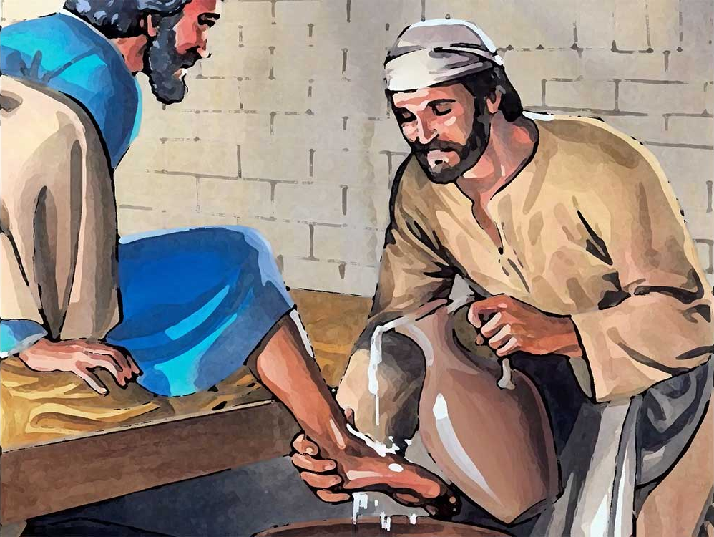

Slide 20
What to do when things
go wrong

Slide 21
In those days when the number
of disciples was increasing,
the Hellenistic Jews among them complained against the Hebraic Jews because their widows were being overlooked in the
daily distribution of food.
Acts 6:1

Slide 22
So the Twelve gathered
all the disciples together and said,
“It would not be right for us to
neglect the ministry of the word of God
in order to wait on tables.
Acts 6:2

Slide 23
‘diakona’ (verse 1)
- physical distribution ministry

Slide 24
‘diakona’ (verse 1)
- physical distribution ministry
‘diakona’ (verse 4)
- teaching/evangelism ministry

Slide 25
… and will give our attention to prayer
and the ministry of the word.
Acts 6:4

Slide 26
1. Apostle’s teaching
2. Fellowship
3. Breaking of bread
4. Prayer
Acts 2:42

Slide 27
Spiritual nature of the task &
so the spiritual qualifications

Slide 28
Brothers & sisters, choose seven men
from among you who are known to be
full of the Spirit and wisdom.
We will turn this responsibility over
to them daily distribution of food.
Acts 6:3

Slide 29
Brothers & sisters, choose seven men
from among you who are known to be
full of the Spirit and wisdom.
We will turn this responsibility over
to them daily distribution of food.
Acts 6:3

Slide 30
Brothers & sisters, choose seven men
from among you who are known to be
full of the Spirit and wisdom.
We will turn this responsibility over
to them daily distribution of food.
Acts 6:3

Slide 31
LOVE
JOY
PEACE
PATIENCE
KINDNESS
GOODNESS
FAITHFULNESS
GENTLENESS
SELF-CONTROL

Slide 32
Brothers & sisters, choose seven men
from among you who are known to be
full of the Spirit and wisdom.
We will turn this responsibility over
to them daily distribution of food.
Acts 6:3

Slide 33
This proposal pleased the whole group.
They chose Stephen, a man full of faith
and of the Holy Spirit; also Philip,
Procorus, Nicanor, Timon, Parmenas,
and Nicolas from Antioch,
a convert to Judaism.
Acts 6:5

Slide 34
Resolving problems -
being peacemakers

Slide 35
Unity in ministry

Slide 36
They presented these men
to the apostles, who prayed and
laid their hands on them.
Acts 6:6

Slide 37
And the result …
So the word of God spread.
The number of disciples in Jerusalem increased rapidly, & a large number of priests became obedient to the faith.
Acts 6:7

Slide 38
So then faith comes by hearing
and hearing by the Word of God.
Romans 10:17

Slide 39
So then faith comes by hearing
and hearing by the Word of God.
Romans 10:17
Preach the word; be prepared in
season and out of season …”
2 Timothy 4:2

Slide 40
And the result …
So the word of God spread.
The number of disciples in Jerusalem increased rapidly, & a large number of priests became obedient to the faith.
Acts 6:7

Slide 41
For us …

Slide 42
Meet the needs of others
Focus on God & others
Act promptly to resolve problems
Seek God in our decision-making
Prioritise God’s Word & prayer
Full of Spirit & wisdom

